Slide 1
Coulomb’s Law
Dr V’s Chemistry webcasts

Slide 2
Objectives
Introduce Coulomb’s Law
Focus on qualitative relationships
Why chemistry students need to know this

Slide 3
Charges interact
Like charges repel
+
+
-
-

Slide 4
Charges interact
Opposite charges attract
-
+

Slide 5
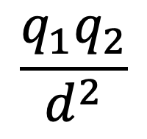
Coulomb’s Law
q₁, q₂: charge magnitudes
$F ∝$
$$\frac{q_{1}q_{2}}{d^{2}}$$
q₁
d
q₂
d—distance between the particles

Slide 6
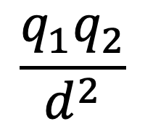
Effect of charge magnitude on attractive force
+1
d
-1
$F ∝$
$$\frac{q_{1}q_{2}}{d^{2}}$$
2.1 x 10⁻⁸ Newtons
+2
d
-1
4.2 x 10⁻⁸ Newtons
As charge magnitude increases,
the strength of the coulombic attraction increases

Slide 7
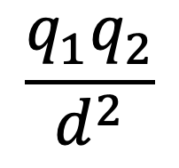
Effect of interparticle distance on attractive force
$$\frac{q_{1}q_{2}}{d^{2}}$$
$F ∝$
+1
d
-1
2.1 x 10⁻⁸ Newtons
+1
2d
-1
0.53 x 10⁻⁸ Newtons
As the distance between the particles increases,
the strength of the coulombic attraction decreases
Charges have a more dramatic effect on the strength of the attraction than distance

Slide 8
Which pair will have the stronger Coulombic attractions?
Fe²⁺ and Cl⁻ OR Fe³⁺ and Cl⁻
Na⁺ and Br⁻ OR K⁺ and Br-
Mg²⁺ and O²⁻ OR Li⁺ and O²⁻
Ca²⁺ and S²⁻ OR Zn²⁺ and S²⁻
Fe³⁺ has a higher charge than Fe²⁺
Na⁺ has a smaller radius than K⁺
Mg²⁺ has a higher charge than Li⁺
Ca²⁺ has a larger radius than Zn²⁺

Slide 9
Coulomb’s Law in chemistry
Explaining periodic trends
Atomic radius trends
Ionization energy trends
PES spectra
Comparing strengths of intermolecular attractions
Explain boiling point and melting trends for ionic compounds
Lattice energy
Can involve different types of interacting particles
Subscribe to my channel!

