Slide 1
Ionization Energy Trends
Dr V’s chemistry webcasts

Slide 2
Objectives
State the period and group trends for ionization energies
Explain why these trends occur
Discuss the trends for multiple ionization energies
Practice problems

Slide 3
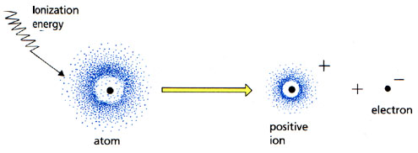
Ionization Energy
:

Slide 4
Ionization Energy
cation
electron
Neutral isolated gas phase atom
Ionization
energy

Slide 5
Ionization Energy
A + IE
➝ A⁺ + e⁻
cation
electron
Neutral isolated gas phase atom
Ionization
energy

Slide 6
Patterns
What elements tend to lose electrons?
METALS
Typically have low ionization energies

Slide 7
Patterns

Slide 8
Ionization Energy

Slide 9
Ionization Energy trends
Period trend
Group trend

Slide 10
What is ionization energy?

Slide 11
Period trends for ionization energy

Slide 12
Group trends for ionization energy

Slide 13
Ionization Energy
First Ionization Energy
Second Ionization Energy

Slide 14
Multiple ionization energies
IE₁
IE₂
2nd ionization energy is usually much larger than the 1st ionization energy
Atoms/ions don’t easily disrupt noble-gas like electron configurations

Slide 16
Summary
Cations have smaller radii than the parent atoms.
Anions have larger radii than the parent atoms.
Group trend: Ionic radii increase down a column
Period trend: Cations get smaller, then anions get smaller
Subscribe to my channel!

