Slide 1
Boyles’ Law and Avogadro’s Law
Bromfield Honors Chemistry

Slide 2
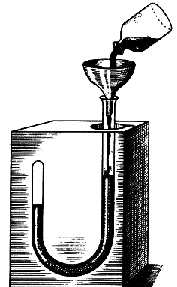
Boyle’s Experiments
“the spring of the air”

Slide 3
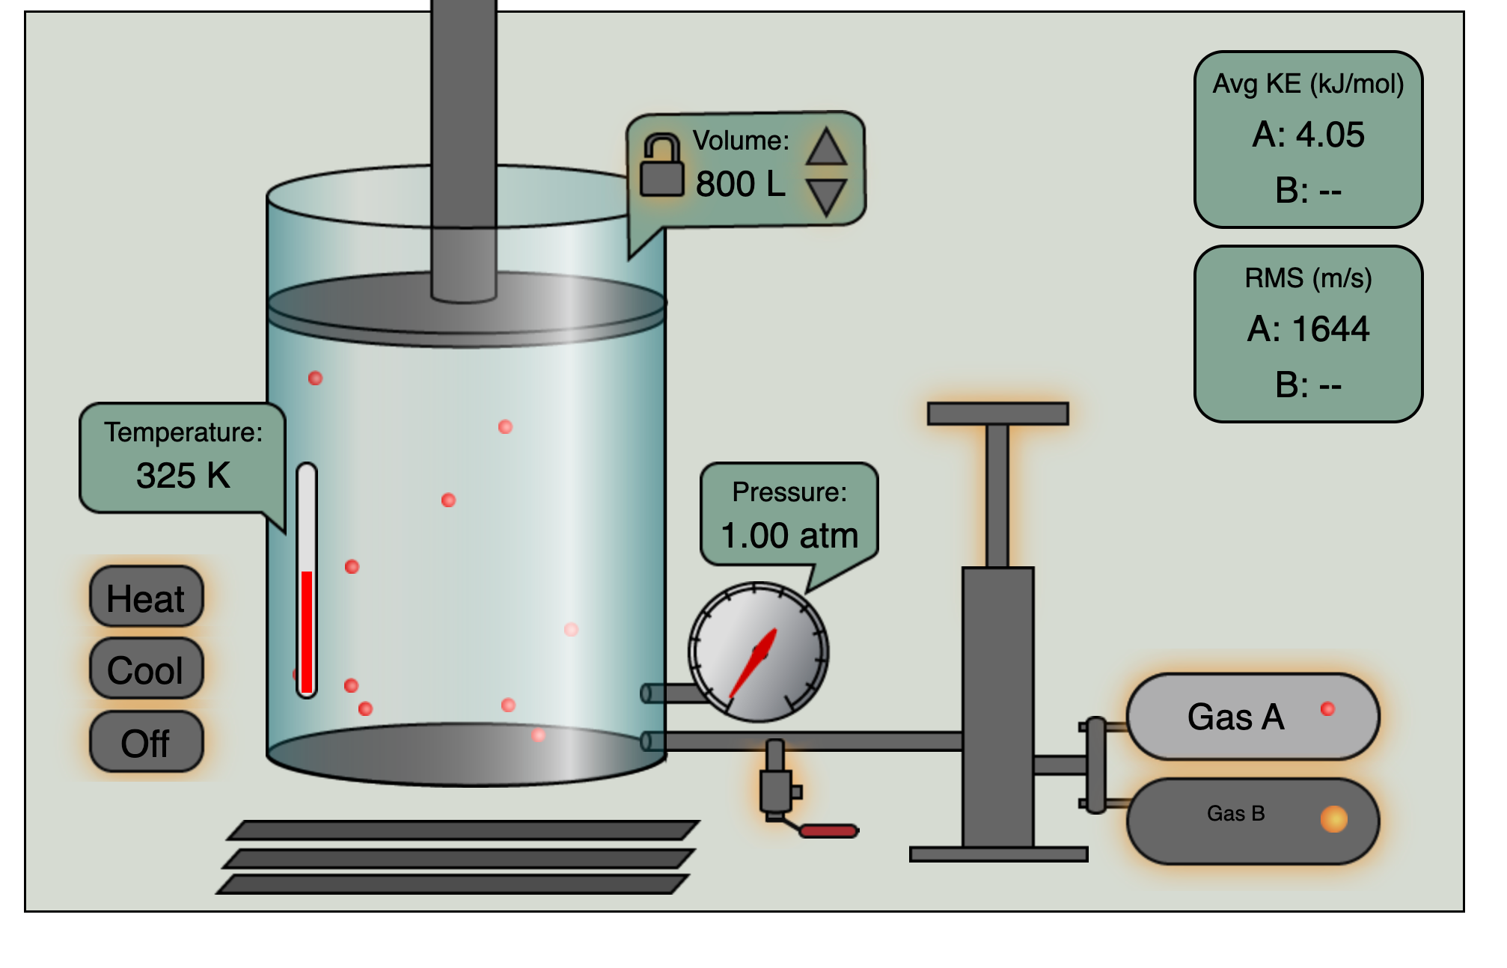
Virtual gas lab simulator

Slide 4
Boyle’s Law
For a confined gas at constant temperature, the pressure is inversely related to the volume of the gas.

Slide 5
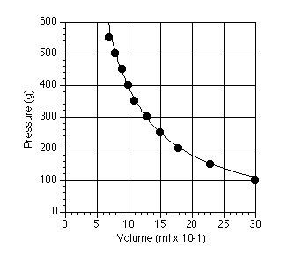
Boyles’ Law

Slide 6
Boyle’s Law Equation
P₁V₁=P₂V₂

Slide 7
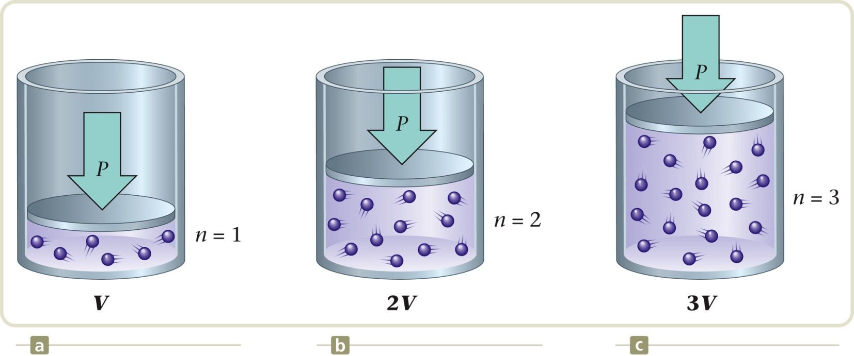
The relationship between volume and moles (n)

Slide 8
Avogadro’s Law
The volume of a gas is directly related to the moles of the gas, when the temperature and pressure remain constant.

Slide 9

Avogadro’s Law
$\frac{V_{1}}{n_{1}}=\frac{V_{2}}{n_{2}}$or $\frac{n_{1}}{V_{1}}=\frac{n_{2}}{V_{2}}$

Slide 10
Sample Problem
Consider two samples of nitrogen gas, N₂. Sample 1 contains 1.5 mol of N₂ and has a volume of 36.7 L at 25ºC and 1 atm. Sample 2 has a volume of 16.5 L at 25ºC and 1 atm. Calculate the number of moles of N₂ in sample 2.
Notes:
0.67 moles in sample 2

Slide 11
Standard Temperature and Pressure
STP
Standard Temperature 0ºC (273 K)
Standard Pressure 1 atm (or equivalent)

Slide 12
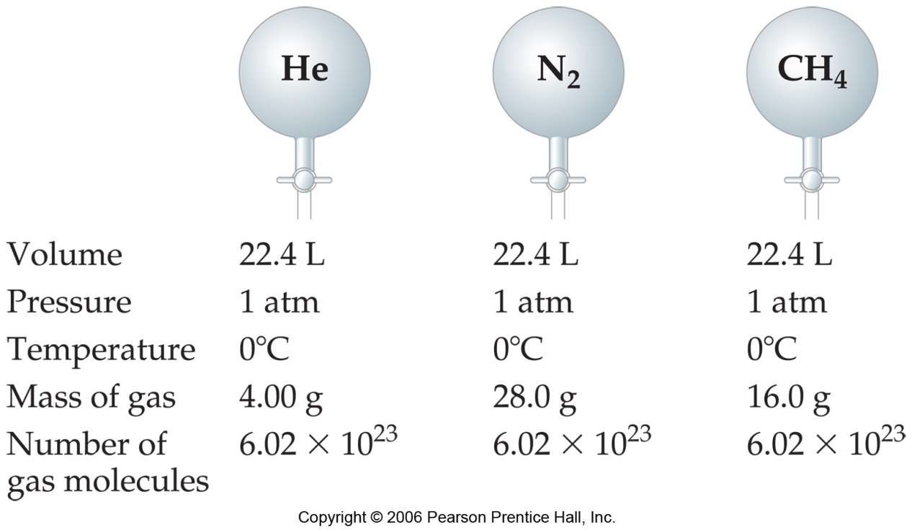
Avogadro’s Hypothesis
Equal volumes of gases at the same temperature and pressure contain equal numbers of particles.

