Slide 1
Periodic Trends
Part III:
Ionization Energy Trends
Electronegativity Trends

Slide 2
Which should have the LARGER radius?
Cs⁺ or Li⁺
Mg²⁺ or F⁻
O²⁻ or N³⁻
K⁺ or Ti²⁺

Slide 3
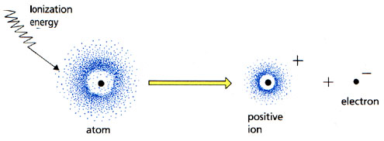
Ionization Energy
:

Slide 4
Ionization Energy
Definition:

Slide 5
Patterns
What elements tend to lose electrons?

Slide 6
Patterns
What elements tend to gain electrons?

Slide 7
Ionization Energy

Slide 8
Ionization Energy trends
Period trend
Group trend

Slide 9
Ionization Energy
First Ionization Energy
Second Ionization Energy

Slide 10
Multiple ionization energies
IE₁
IE₂
2nd ionization energy is usually much larger than the 1st ionization energy
Atoms/ions don’t easily disrupt noble-gas like electron configurations

Slide 11
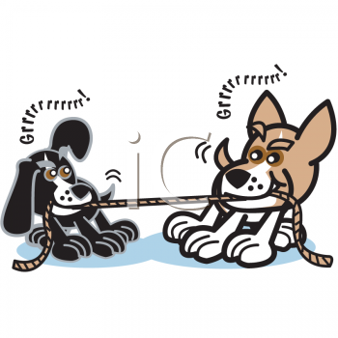
Electronegativity
Definition:

Slide 12
Electronegativity
Most electronegative element:
Least electronegative element:

Slide 13
Electronegativity Trends

Slide 14
Electronegativity
Period Trend:
Group Trend:

Slide 15
Exceptional Electron Configurations
Some elements have electron configurations that don’t follow the arrow-filling diagram
Ex. Cu
Expected:
Actual:

Slide 16
Exceptional Electron Configurations
Some elements have electron configurations that don’t follow the arrow-filling diagram
Why?
Minimize electron-electron repulsions with symmetric, spherical electron clouds
half-filled or fully filled sublevels

Slide 17
Electron Affinity
Note: your book uses a different convention…do not read about EA in your textbook!
The energy change that occurs when an electron is added to an ISOLATED (gaseous) atom
How easily does an atom gain an electron?

Slide 18
Electron affinity
The greater the attraction between an atom and an added electron, the more energy is given off…more negative EA

Slide 19
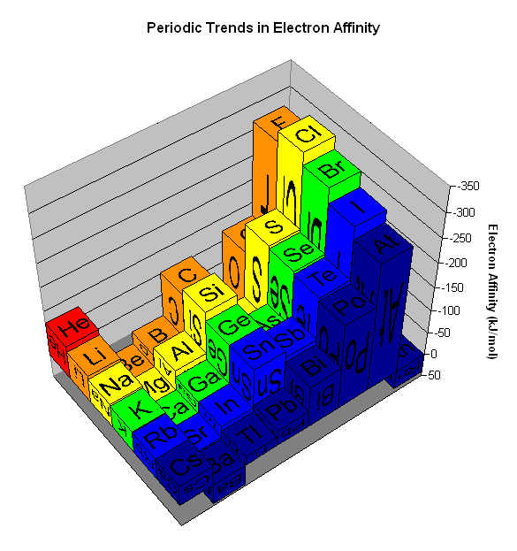

Slide 20
Electron Affinity
Nonmetals typically have a high, negative electron affinity.
(-) EA: element readily gain electrons

Slide 21
Electron Affinity
Metals typically have a low electron affinity.
Slightly negative or (+) EA: putting an electron in a higher energy sublevel is energetically unfavorable

Slide 22
Electron affinity
Group trend:
Electron affinity DECREASES slightly down a column
Electron is added to an energy level farther from the nucleus, so the coulombic attraction is weaker

Slide 23
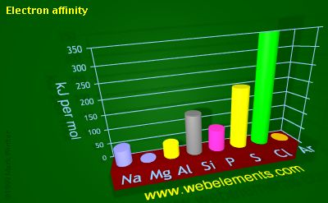
Period trend
Discrepancies?

Slide 24
Electron affinity
Period trend:
Electron affinity generally INCREASES L→R across a period
Discrepancies
Group 2, noble gases: low or positive electron affinity
Place additional electron in a higher energy level

Slide 25
Electron affinity
Period trend:
Electron affinity generally INCREASES L→R across a period
Discrepancies
Group 15: an additional electron would have to share an orbital…More electron-electron repulsions

