Slide 1
Mole to Mole Stoichiometry Problems
Dr V’s Chemistry Webcasts

Slide 2
Objectives
Use dimensional analysis to solve mole:mole stoichiometry problems
Get your calculator!

Slide 3
Strategy
Read the problem carefully!
Start with a balanced equation
List what you know!
What are you solving for?
What are you given?
Set up the factor label
Mole ratio from the balanced equation
Make sure units cancel
Substitute and evaluate
Report your answer with appropriate units
Record the correct number of significant figures

Slide 4
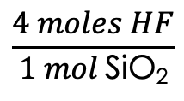
How many moles of hydrofluoric acid, HF, are required to react completely with 2.78 moles of silicon dioxide, SiO₂, according to the equation below?
Start with a balanced equation!
___HF + ___SiO₂ ➝ ____SiF₄ + ____H₂O
? moles
2.78 moles
Mole ratio:
4 moles HF: 1 mol SiO₂
X moles HF = 2.78 moles SiO₂
$$\frac{4 moles HF}{1 mol \text{SiO}\text{2}}$$
= 11.1 moles HF
3 sig figs

Slide 5
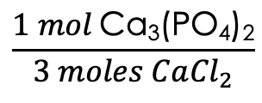
How many moles of precipitate will form if 0.45 moles of calcium chloride react completely according to the equation below?
Start with a balanced equation!
___CaCl_{2(aq)} + ___Na₃PO_{4(aq)} ➝ ___Ca₃(PO₄)_{2(s)} + ____NaCl_{(aq)}
0.45 mol
Get the mole ratio from the coefficients
3 moles CaCl₂:1 mole Ca₃(PO₄)₂
X moles Ca₃(PO₄)₂ = 0.45 moles CaCl₂
$$\frac{1 mol \text{Ca}\text{3}\text{(}\text{PO}\text{4}\text{)}\text{2}}{3 moles Ca{Cl}_{2}}$$
= 0.15 moles Ca₃(PO₄)₂

Slide 6
Found this helpful?
Like the video!
Leave a comment!
Subscribe to my channel!

