Slide 1
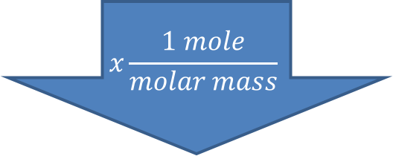
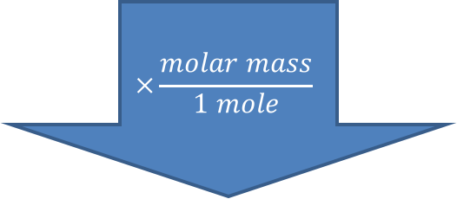
Begin here if you are given grams
The Mole Road—Solving Stoichiometry Problems
Grams of substance given
$$x\frac{1 mole}{molar mass}$$
Begin here if you are given moles
× moles substance needed
moles substance given
Stop here if solving for moles
Moles of substance given
Moles of substance needed
$$×\frac{molar mass}{1 mole}$$
Grams of substance needed
Stop here if solving for grams

