Slide 1
Bond Length vs. Bond Strength
Dr V’s chemistry webcasts

Slide 2
Objectives
Determine the relationship between bond type and bond energy
Relate bond type and bond length
Practice problems

Slide 3
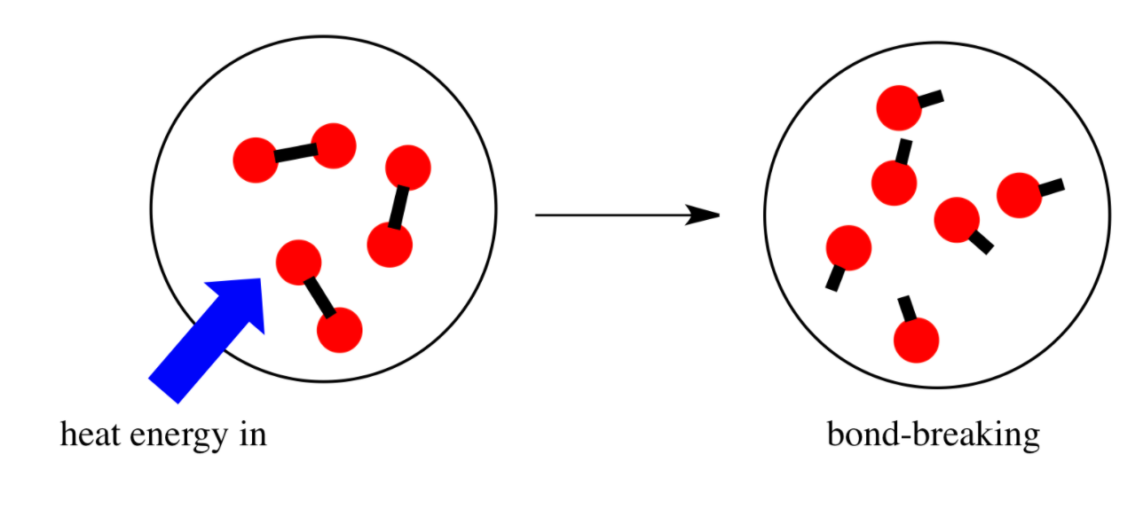
Bond Dissociation Energy
The energy required to break a bond and form neutral isolated atoms
Also called “bond energy”

Slide 4
Bond order
C-C vs. C=C vs. C≡C
Bond order: number of pairs of electrons shared between two atoms
Bond | Bond order
C-C | 1
C=C | 2
C ≡ C | 3

Slide 5
Trends in bond energy
Bond | Bond energy, kJ/mol
C-C | 348
C=C | 614
C ≡ C | 839

Slide 6
Trends in Bond Energy
C-C vs. C=C vs. C≡C
Multiple bonds have higher bond energies than single bonds
Double bonds are stronger than single bonds
Bond | Bond energy, kJ/mol
C-C | 348
C=C | 614
C ≡ C | 839

Slide 7
Trends in bond energy
A double bond isn’t twice as strong as a single bond
Bond | Bond energy, kJ/mol
C-C | 348
C=C | 614
C ≡ C | 839

Slide 8
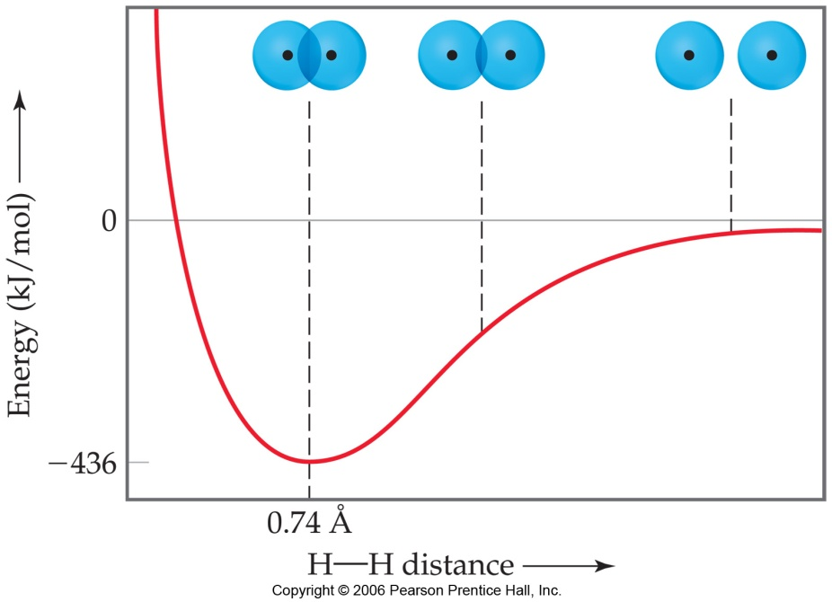
Bond Length
The average distance between two bonded atoms
The distance between nuclei at their minimum potential energy

Slide 9
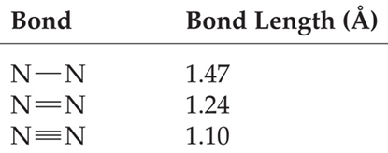
Bond Length & Bond Order

Slide 10
Bond Order & Bond Length
More pairs of electrons shared between the atoms leads to a shorter bond length

Slide 11
Bond Energy & Bond Length
Longer bond lengths ⇒ lower bond dissociation energies
“Short bonds are strong bonds”
Higher bond dissociation energy is linked to lower chemical reactivity

Slide 12
Apply…
Which bond would you expect to have the shortest bond length?
Bond 3
Triple bonds are shorter than single or double bonds

Slide 13
Apply…
Which bond would you expect to have the lowest bond dissociation energy?
Bond 2
Single bonds are weaker than double or triple bonds

Slide 14
Wrapup
Short bonds are strong bonds!
As more electron pairs are shared between atoms:
Bond length decreases
Bond dissociation energy increases
Subscribe to my channel!

