Slide 1
Intermolecular Forces
Attractions between molecules

Slide 2
Overview
Molecules may be weakly attracted to each other.
There are various categories of intermolecular attractions.
Intermolecular attractions affect macroscopic properties of compounds.

Slide 3
Intermolecular attractions
Also called “van der Waals forces” or “weak forces”
Generally weak
Cumulative effect can be significant

Slide 4
Intermolecular attractions
Depend on several factors
Molecule size
Molecule polarity
Number of bonding electrons
Affect molecular properties
Boiling point, evaporation time, melting point, viscosity

Slide 5
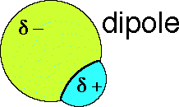
Dipole
i.e., a polar molecule

Slide 6
Ion-dipole attractions
Animation—dissolving a salt in water
Strongest of the weak forces
Ions attract polar molecules
An ion interacts with a polar molecule

Slide 9
Ion-dipole attractions
Important role in dissolving ions in water
Enough of these can break apart a crystal lattice

Slide 10
Dipole dipole attractions
Dipoles arrange themselves to maximize attractions & minimize repulsions
Animation
Two polar molecules interact

Slide 11
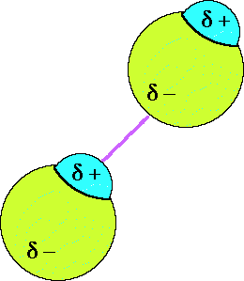
Dipole dipole attractions
Opposites attract
Dipoles arrange themselves to maximize attractions & minimize repulsions

Slide 12
Dipole dipole attractions
δ− δ+

Slide 13
Dipole dipole attractions
Strength depends on the nature of the dipoles involved
Explains why water expands when it freezes!

Slide 14
Hydrogen bonding
Hydrogen attached to O, N or F
H almost bare of electron density
Attracted to another molecule’s O, N or F atom (Finds electron density on another atom)
Recent insight: some covalent character

Slide 15
Hydrogen bonding in water
Relatively strong intermolecular attractions
H bonded to N, O or F in one molecule is attracted to another molecule’s N, O or F

Slide 16
Hydrogen bonding in water

Slide 17
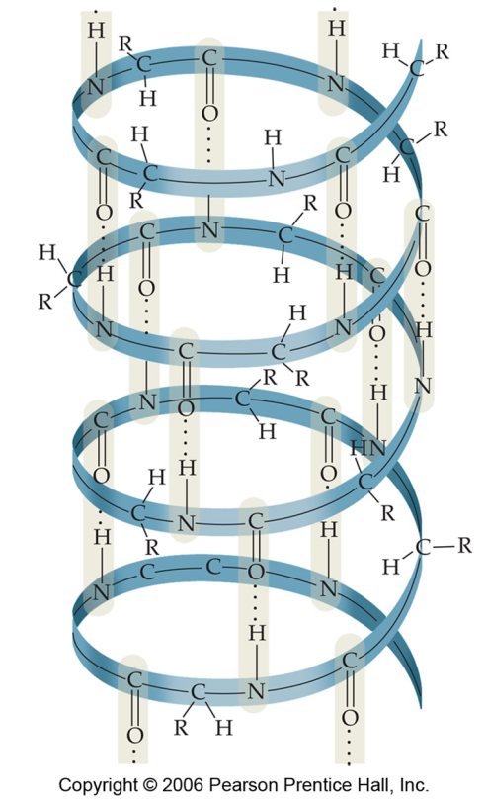
Hydrogen bonding
Subset of dipole-dipole interactions
Important in protein, DNA structure
Alpha helix in protein
Hydrogen bonding in DNA

Slide 18
Dipole-Induced Dipole Attractions
Presence of a permanent dipole can “induce” a temporary dipole in another molecule
Temporary effect
A polar molecule interacting with a nonpolar molecule

Slide 19
Inducing a dipole
δ -
δ+
Spherical nonpolar atom
- +
- +
Dipole causes temporary uneven distribution of electrons
Dipole approaches from a distance

Slide 20
Dipole-induced dipole attractions

Slide 21
Dipole-induced dipole attractions
Explains why O₂, CO₂ can dissolve in water
Water—a very polar molecule!

Slide 22
Induced dipole-induced dipole attractions
“London dispersion forces”
Weakest of the intermolecular attractions

Slide 23
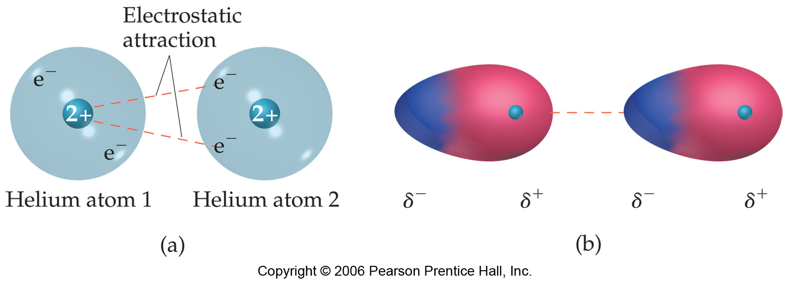
Induced dipole-induced dipole attractions
Animation
Notes:
Like a tempurpedic pillow

Slide 24
Induced dipole-induced dipole attractions
Randomness in electron motion can result in uneven electron distribution for a moment
Transient effect
This can temporarily induce a dipole in another molecule
All types of matter can participate in London forces
Only IMF possible for nonpolar molecules

Slide 25
Comparison: Dipole dipole interactions vs. London forces
Animation

Slide 26
Induced dipole-induced dipole attractions
Most significant for more massive atoms
Larger electron cloud is more easily distorted (more “polarizable”)
Compare iodine and fluorine molecules
I₂ … 106 electrons in electron cloud…found as a solid at room temperature
F_{2…} 18 electrons in electron cloud…found as a gas at room temperature

Slide 27
Effects of intermolecular attractions
Stronger intermolecular attractions → difficult to separate molecules
High boiling point
May be solid or liquid at room temperature

Slide 28
Effects of intermolecular attractions
Weaker intermolecular attractions → easy to separate molecules
Low boiling point
May be gases or liquids with low boiling points (“volatile”)

